Slide 1

Academic Session 2026-27
ODD Semester July-Dec 2026
UNIVERSITY INSTITUTE OF ENGINEERING AND TECHNOLOGY
Department of TT
Bachelor of Engineering (B.E.) – CSE
Advanced Data Structures / Semester 3
(CS220)
Unit No. 1 Chapter No. 1.1 Lecture No. 11
Topic : Merging Arrays and Merge Sort
Abhishek Thakur (E19789) Technical Trainer
Sourav Jaiswal (E19756)-MSC Technical Trainer

Slide 2
Learning Objectives
Understand how to merge two sorted arrays efficiently in O(n+m) time.
Trace the Merge Sort algorithm using a recursion tree diagram.
Derive the O(n log n) time complexity of Merge Sort from its recurrence.
Compare Merge Sort with Bubble Sort and Quick Sort in practical scenarios.

Slide 3
Merging Two Sorted Arrays
Problem: Given two sorted arrays A[0..m-1] and B[0..n-1], produce a single sorted array C[0..m+n-1].
Algorithm: Use two pointers i=0, j=0. While i less-than m and j less-than n: if A[i] less-than= B[j]: C[k++]=A[i++]; else: C[k++]=B[j++]. Copy remaining elements.
Time complexity: O(m+n) — each element is visited exactly once.
Space complexity: O(m+n) — auxiliary array C needed to hold merged result.

Slide 4
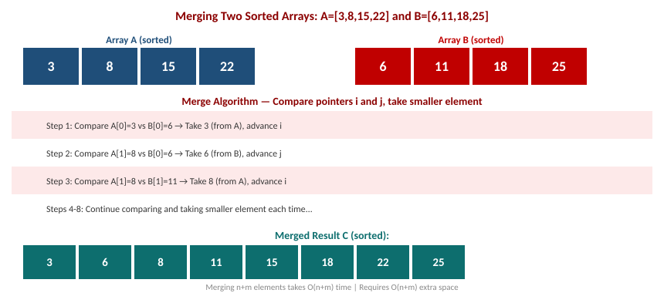
Merging Two Sorted Arrays — Step-by-Step

Slide 5
Merge Sort — Algorithm
Strategy: Divide and Conquer — recursively split array into halves until single elements, then merge back.
Algorithm: MERGESORT(A, lo, hi): if lo less-than hi: mid=(lo+hi)/2; MERGESORT(A,lo,mid); MERGESORT(A,mid+1,hi); MERGE(A,lo,mid,hi)
Recurrence: T(n) = 2T(n/2) + O(n). By Master Theorem: T(n) = O(n log n).
Guaranteed: O(n log n) in ALL cases — best, average, and worst. No bad pivot problem.
Trade-off: Requires O(n) extra space for auxiliary array.

Slide 6
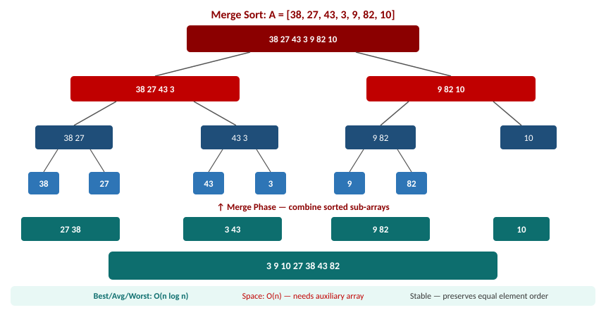
Merge Sort — Recursion Tree and Merge Phase

Slide 7
Summary of the Lecture
Merging two sorted arrays of sizes m and n takes O(m+n) time and O(m+n) space.
Merge Sort recursively splits the array into halves and merges sorted sub-arrays.
Recurrence: T(n) = 2T(n/2) + O(n), solved to T(n) = O(n log n) by Master Theorem.
Merge Sort is stable and guaranteed O(n log n) — no worst-case degradation unlike Quick Sort.
Trade-off: O(n) extra space required. Preferred for linked lists and external sorting.

Slide 8

Next Lecture
Multi-dimensional Arrays — 2D/3D representation, address formulas, and applications.

Slide 9
Quiz/ FAQ's
Q1. Write the MERGE algorithm for two sorted arrays. What is its time and space complexity?
Q2. Trace Merge Sort on A = [38, 27, 43, 3]. Show all splits and merges step by step.
Q3. Derive the O(n log n) complexity of Merge Sort using the recurrence relation T(n) = 2T(n/2) + n.

Slide 10
References/ Articles
Cormen et al., Introduction to Algorithms (CLRS), 3rd Ed., MIT Press, Ch. 2.3, 4.5.
GeeksforGeeks — Merge Sort: https://www.geeksforgeeks.org/merge-sort/
Visualgo — Sorting: https://visualgo.net/en/sorting

Slide 11
Thank You
For queries
Email: abhishek.e19789@cumail.in

